Slide 1
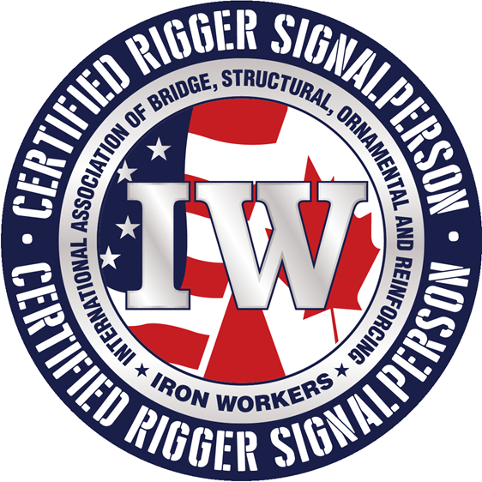
RAISING THE BAR: Ironworker Rigger & Signal-Person Certification Program

Slide 2
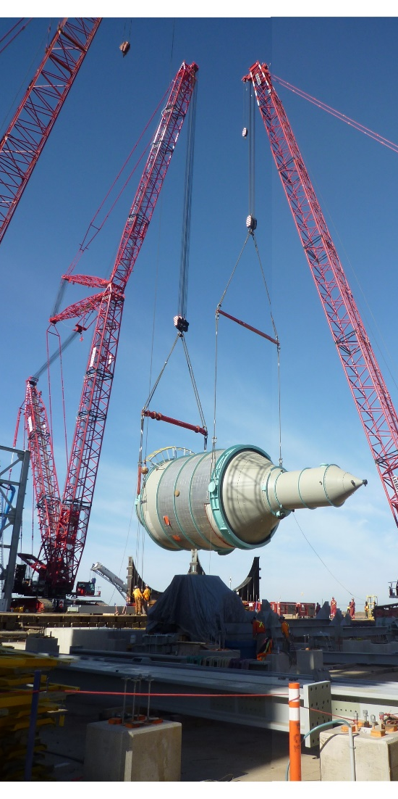
The Ironworkers International Certification Board (IICB)
presents
Ironworker Rigging and Signal Person Certification

Slide 3
IICB Committee
Lee Worley – Chairman
Pete Hayes – Secretary, Red Cedar Steel
Kendall Martin – VP & DC President Mid-Atlantic States
Bill Brown – Ideal Construction, Co-Chair Impact
Jason Corder – Apprenticeship & Training Department Washington, DC
Matt Lanham – Barnhart Crane
Dr. Jerry Wircenski – Public Member, Univ. of North Texas
Certification Director – Brian Tannehill, Apprenticeship & Training Department Washington, DC

Slide 4
IICB Mission Statement
The Ironworkers Rigger and Signalperson Certification Program provides members a practical method to obtain a certification that accurately evaluates their rigging and signaling competence. By ensuring that only trained, skilled and competent Ironworkers complete rigging and signaling tasks, workplace risk is reduced, and safety is increased, standing true to our efforts to ensure all workers return home safe at the end of the day. By certifying skilled and qualified workers, the Iron Workers’ Certification Board is promoting a safe and efficient jobsite for the worker, the public, and the industry.

Slide 5
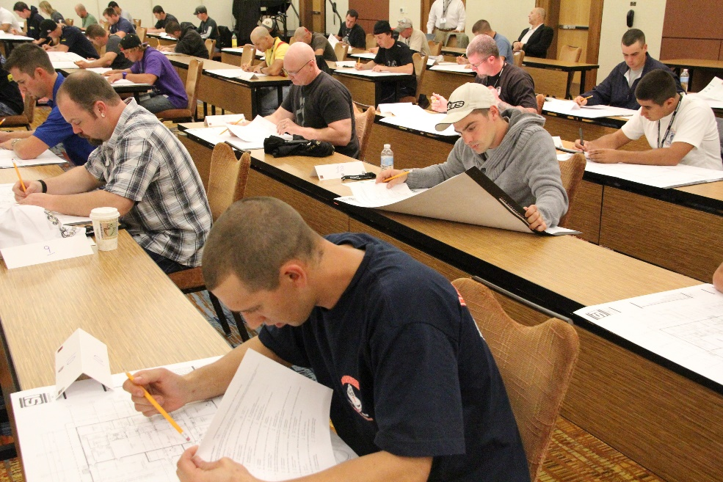
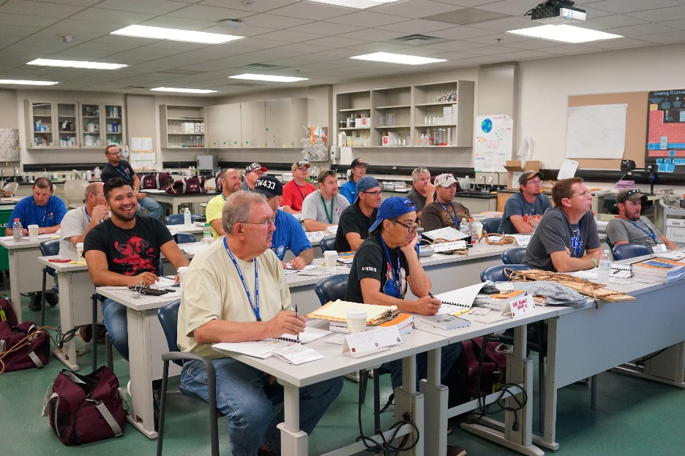
Why we did it: The Ironworkers have had a Qualified Rigger and Signal Person program for years, where training, testing and record keeping were key parts of the program.

Slide 6
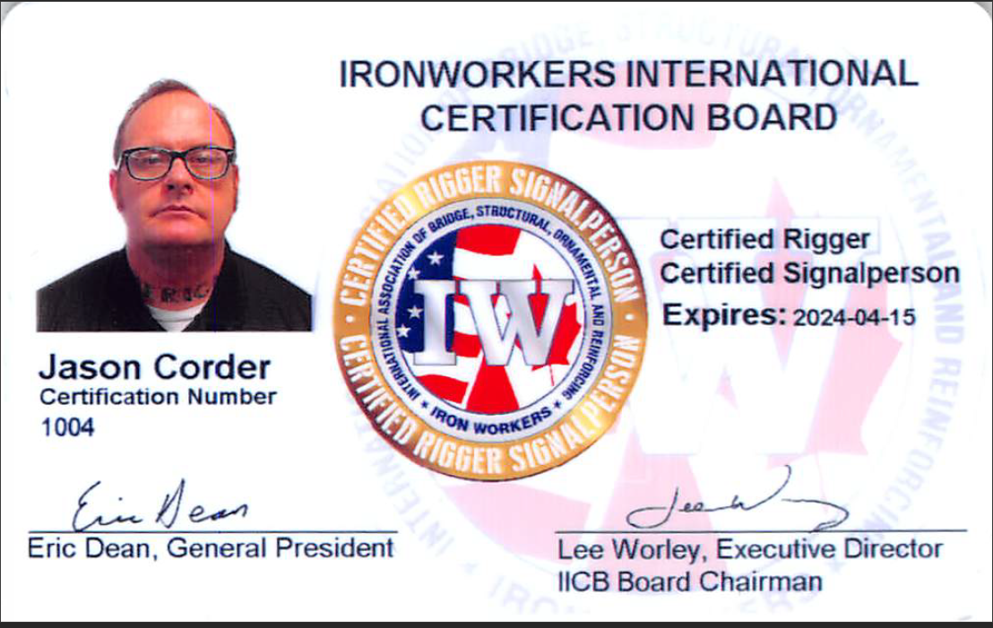
Why Ironworker Certifications are Better
What’s Behind the Card

Slide 7
Requirements for certification include the following:
Must be a member of the Iron Workers in good standing
Comply with the IICB substance abuse policy
Have 6,000 hours of industry related experience
Must have completed and passed the Ironworkers Rigging and Crane course or Equivalent
Sign the confidentiality policy and examination rules
Pass the written examination
Pass the practical examination

Slide 8
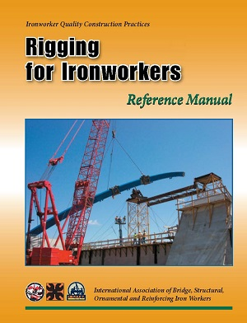
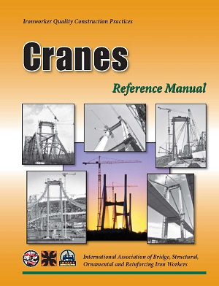
The Best Training
80 hours minimum training in Rigging and Cranes
23 Units of Instruction
Written assignments, practical exercises, and unit testing.
700 hours minimum field experience (Qualified Rigger)
ATS Verification

Slide 9
What topics are covered in the written exam?
Codes and Regulation
Crane set up & load charts
Rigging components
Voice and hand signals
Rigging inspection
Lifting procedures
Hitches
Rigging safety

Slide 10
What performance exercises are required in the practical exam?
Perform Hand and voice signals
Perform slings & Hardware inspection
Perform basic hitches
Tie 6 knots
Rig, Transfer and Invert a load

Slide 11
What are the recertification requirements?
To recertify you must take and pass a written exam prior to the 5-year expiration date. There is no grace period. Therefore, it is recommended to take the recertification exam prior to the expiration date.

Slide 12
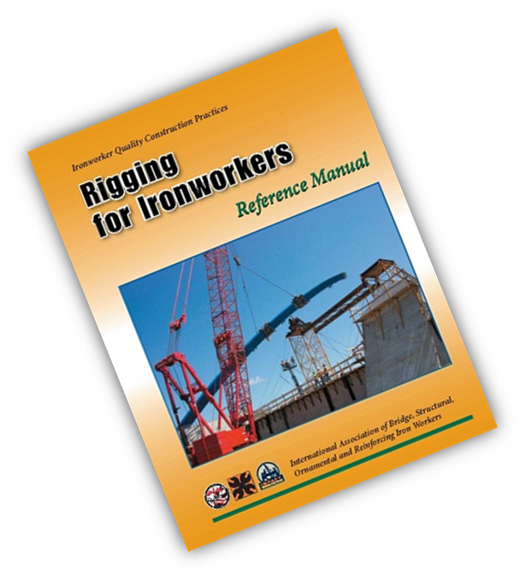
Industry Recognized Quality
The NCCCO lists the Ironworker Rigging Manual as a study resource for their certification Test.
The Southern Company
Numerous General Contractors & Sub-Contractors across North America

Slide 13
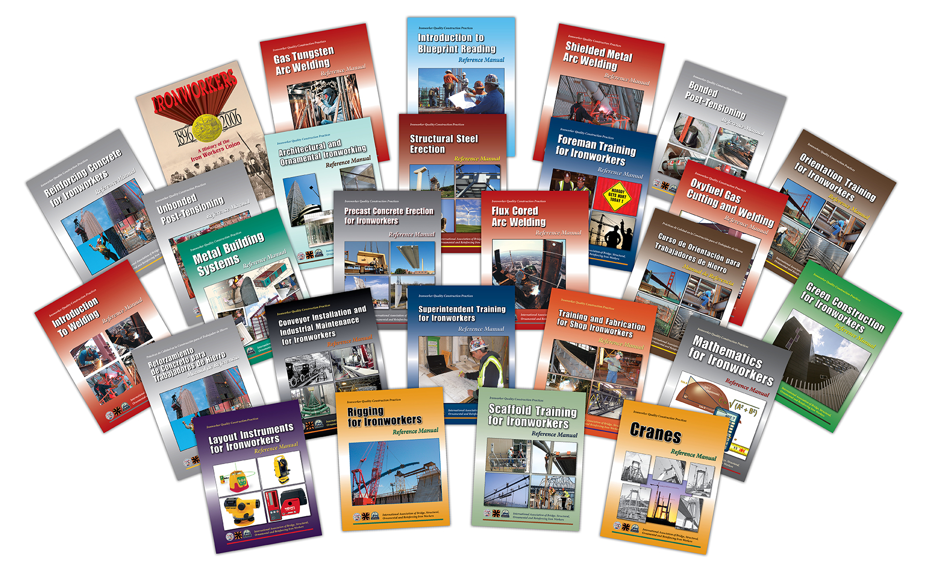

Slide 14
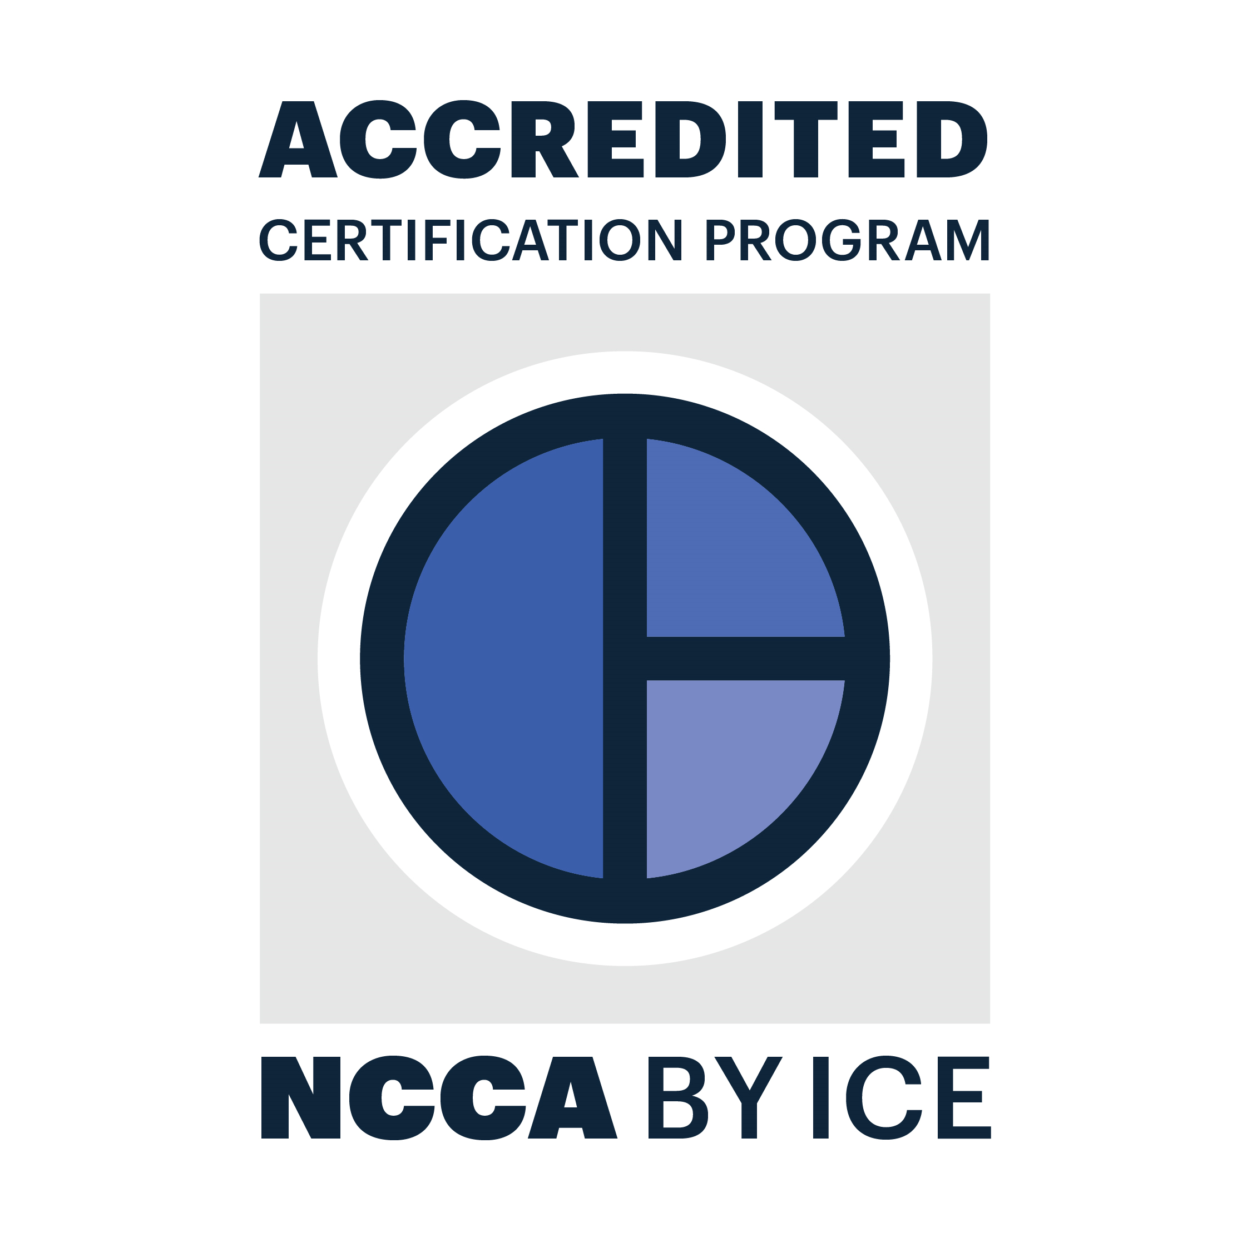
Why Ironworkers Certification for Rigging and Signaling?
One of the most comprehensive and rigorous Rigging and Signaling Certification Program available
It’s What’s behind the certification that REALLY matters!

Slide 15
For more Information go to:
http://www.ironworkers.org/training/iicb-certification-program
Questions/Comments:
Contact the Apprenticeship & Training Department at…
202-383-4889
lworley@iwintl.org

