Slide 1

PREVENT THE FIRST DOSE, PREVENT THE OVERDOSE: HOW THE LATEST SCIENCE CAN TREAT PAIN WITHOUT RELYING ON OPIOIDS

Slide 2

John Greenwood
  COO, Goldfinch Health
  Clinical Researcher - Pharmacology
  Surgical Clinical Educator
  Family member of an SUD laborer
  Father of a 5X surgical patient

Slide 3

SEARCHING FOR A BETTER SURGERY EXPERIENCE
Protect your people from the pitfalls of surgery.
>90%
of surgeries are more invasive than necessary
Invasive surgery
extends pain, recovery time and return to normal life by weeks to months
Invasive surgery is the
#1 gateway to opioid addiction
Notes:
The reality is that your people are unknowingly at risk when they go through surgery on their own.
>90% of surgeries are more invasive than necessary
Invasive surgery extends pain, recovery time and return to normal life by weeks to months.
Invasive surgery is the #1 gateway to opioid addiction
The result – your people are out longer than they should, your healthcare and disability costs go up and your productivity goes down – making it harder for you to hit your yearly plans on all fronts.

Slide 4
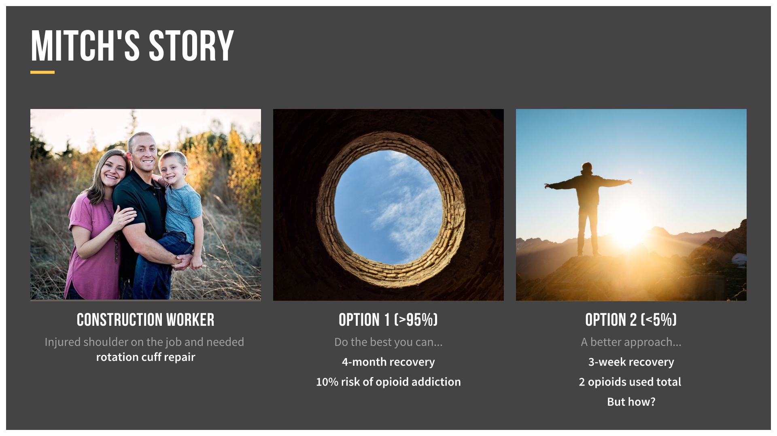

Slide 5


Slide 6
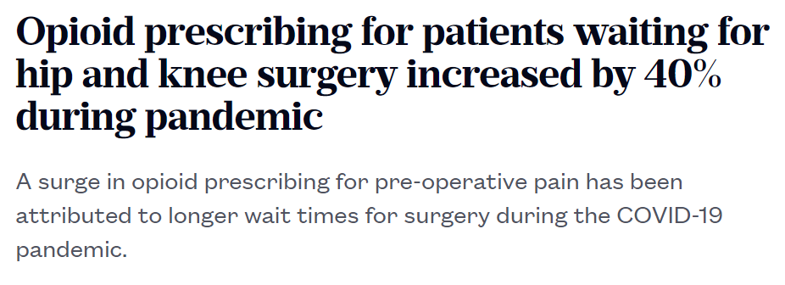
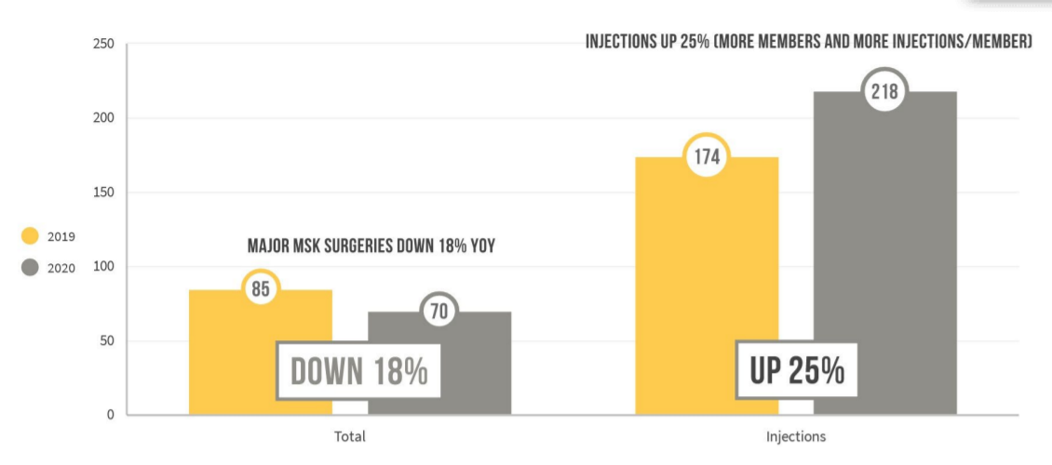
Post-Pandemic Challenges

Slide 7
The recipe for success
A comprehensive approach to surgery and recovery.
Prior to
surgery
Surgery +
Hospital Stay
At-Home Recovery
Return to work
Tailored Pre-Op Nutrition Plan
Pre-Surgery Pain Management Plan
Minimally Invasive Approach
Multi-Modal Pain Management
Expectation Setting
Opioid-Sparing Pain Management
Recovery Support from a Nurse Navigator
Complication Monitoring
2X FASTER
RETURN TO WORK AND LIFE
Physical / psychological stress
optimized
Surgery + Recovery Experience
Traditional
Surgery experience
Open, invasive procedure
Opioids to control pain post-op
“Don’t eat or drink after midnight.”
Patient enters surgery in a weakened state
Opioids to control pain
Weeks without provider support
Prior to
Surgery
Surgery +
Hospital Stay
At-Home Recovery
Return to work

Slide 8



ERAS + Nurse Support
Faster Recovery. Fewer Opioids. Happier Patients.
32
days faster return to work per patient
92%
Reduction in refills from people already on opioids
<2%
Readmission rate

Slide 9
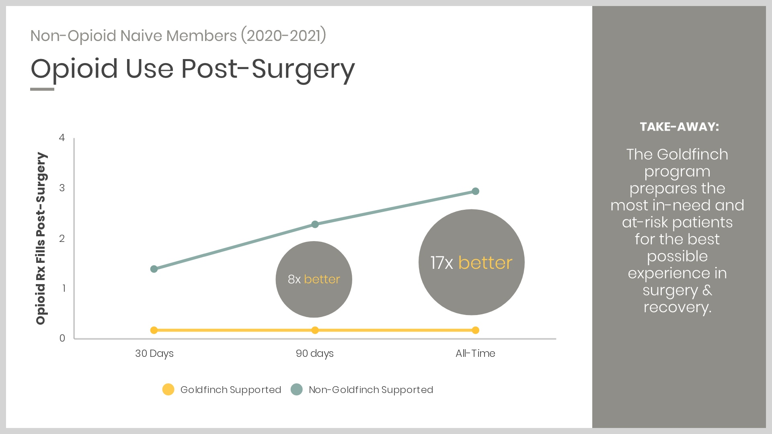

Slide 10
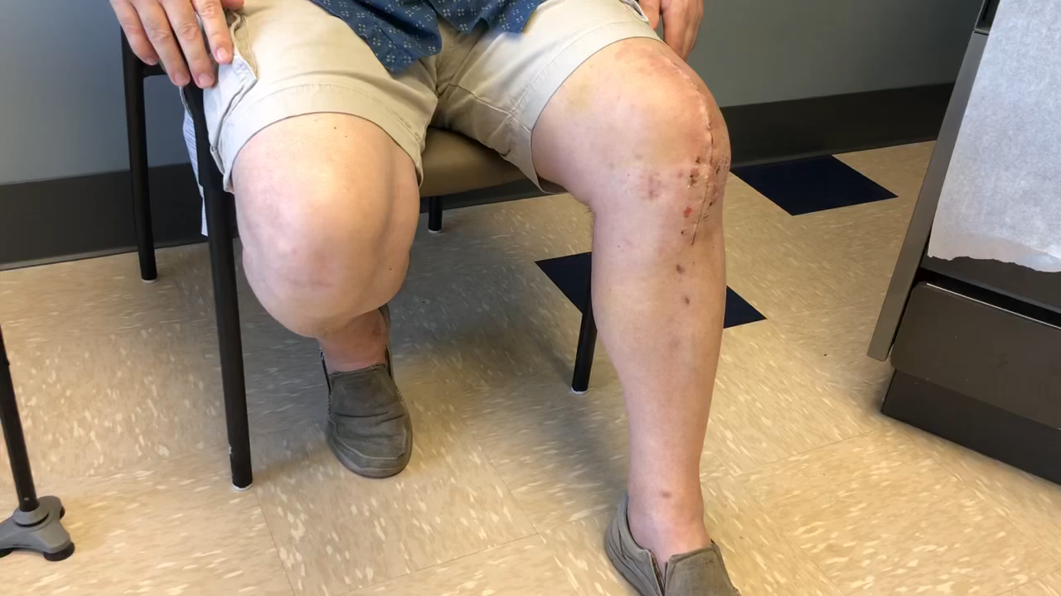
2 Weeks Post-Op with Zero opioids

Slide 11
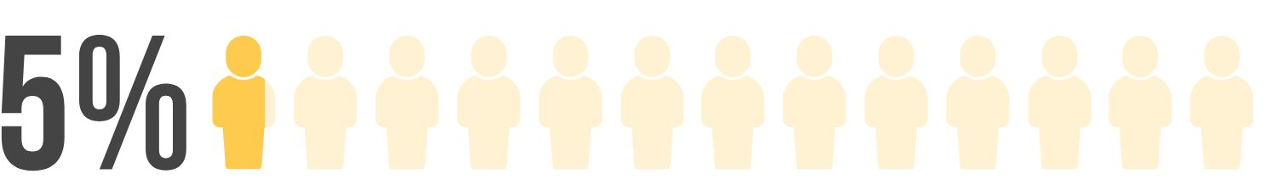
SEARCHING FOR A BETTER SURGERY EXPERIENCE
The odds aren’t in your favor.
Surgeons, for common procedures, who have adopted approaches to surgery that fast-track recovery time and protect patient against opioid addiction

Slide 12
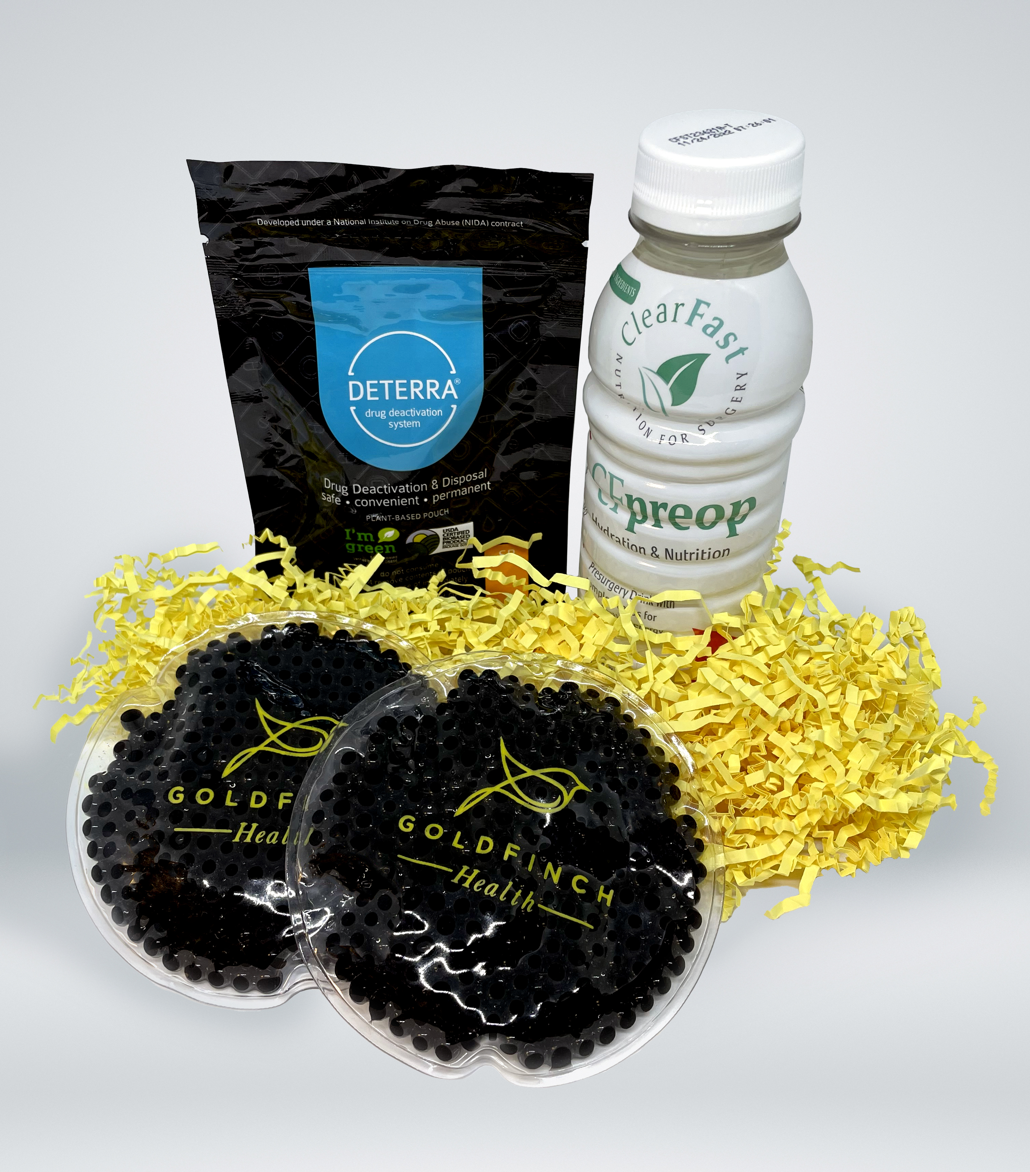
What Can You Do?
Encourage your members to speak UP about opioid alternatives
Speak with you plan about opioid sparing strategies
Consider Nurse support around these critical period
Download 10 questions for your surgeon at:
Goldfinchhealth.com
Provide Deterra Packs to members:

Slide 13
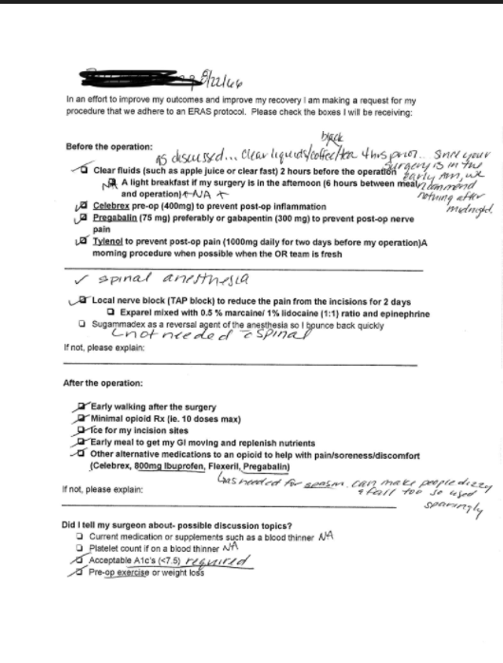

Slide 14

Get in Touch
With Us
John Greenwood
Co-Founder/COO
833.453.3624 x701 (office)
319.331.0049 (cell)
John.Greenwood@goldfinchhealth.com

