Slide 1
Growing Your Way to Effective Scheduling: Introduction to the “Whys” and “Hows” of Building Effective Schedules with Microsoft Project

Slide 2
Introduction to today’s presenter
Nancy Brister, PMP
AlignAbilities Consulting Services
nbrister@alignAbilities.com
602.793.2204

Slide 3
Welcome to Today’s Webcast!
Today’s webcast is designed to build understanding of key project management concepts as a basis for facilitating effective change with focus on:
Why Project Management Matters
Why Setting Up for Project Success is Important
How Key Accepted Scheduling Practices Work
How to Schedule with Microsoft Project
Notes:
Goal: to provide key essential insights and ideas as a starting and growing point for more effective project and change outcomes to better understand:
WHY PROJECT MANAGEMENT MATTERS: Why key project management concepts and terminology are building blocks for successful projects
WHY ACCEPTED PLANNING PROCESSES AND TECHNIQUES MATTER: Why using consistent processes and planning techniques will ultimately save you time
HOW TO ACCEPTED/ “TRIED and TRUE” SCHEDULING TECCHNIQUE WORK basic “tried and true” scheduling practices will support you in defining and organizing project schedules
HOW MICROSOFT PROJECT IS A USEFUL SCHEDULING TOOL: How Microsoft Project can serve as a tool to advance greater insights for you and your team

Slide 4
Why Project Management Matters
What is Project Management
Common Project Problems
Dissatisfied customers or stakeholders
Misunderstood expectations/deliverables
Project boundaries/scope management
Inappropriate budgets
Inappropriate schedules
Over-worked or under-worked resources
Inadequate or inappropriate organizational support
Project versus Operational Work

Slide 5
Why Project Management Matters
Developing a common, consistent terminology (lexicon) to support effective communication:
Stakeholders
Process
Scope
Deliverables
Activities
Milestones
Constraints
Assumptions
Requirements needs and wants
Resources

Slide 6
Why Project Management Matters
TIME
COSTS
(including Resources)
Quality
Scope
Balancing Project Constraints: Managing RISKS

Slide 7
Why Setting Up for Success Matters :
Time - Schedule
Costs - Resources
Quality - Control
Scope -
Requirements
RISKS
Continuous monitoring and process improvement

Slide 8
Why Setting Up for Success Matters :
A | Align | To arrange, connect, and establish context to the "big picture"
P | Plan | To define and estimate the actions needed to achieve a goal
R | Respond | To assign roles and have others and self be accountable
O | Organize | To create frameworks that support order and form
J | Justify | To reasons and explain the value of expending resources
E | Elaborate | To expand visions and Ideas into concrete actions
C | Communicate | To relay information meaningfully and effectively
T | Translate | To convert ideas and expectations into tangible results

Slide 9
How Key Scheduling Practices Work :
Act
Do
Check
Define
PLAN
Adjust

Slide 10
How Key Scheduling Practices Work :
A Quick Reference Checklist:
Define Project Goals
Know Stakeholders’ Interests
Determine Project Needs and Requirements
Understand Project Constraints
Identify Risks
Identify Requirements for Quality
Determine Resources
Determine Scope
Develop a Schedule
Develop a Budget
Integrate all of the above to achieve project goals

Slide 11
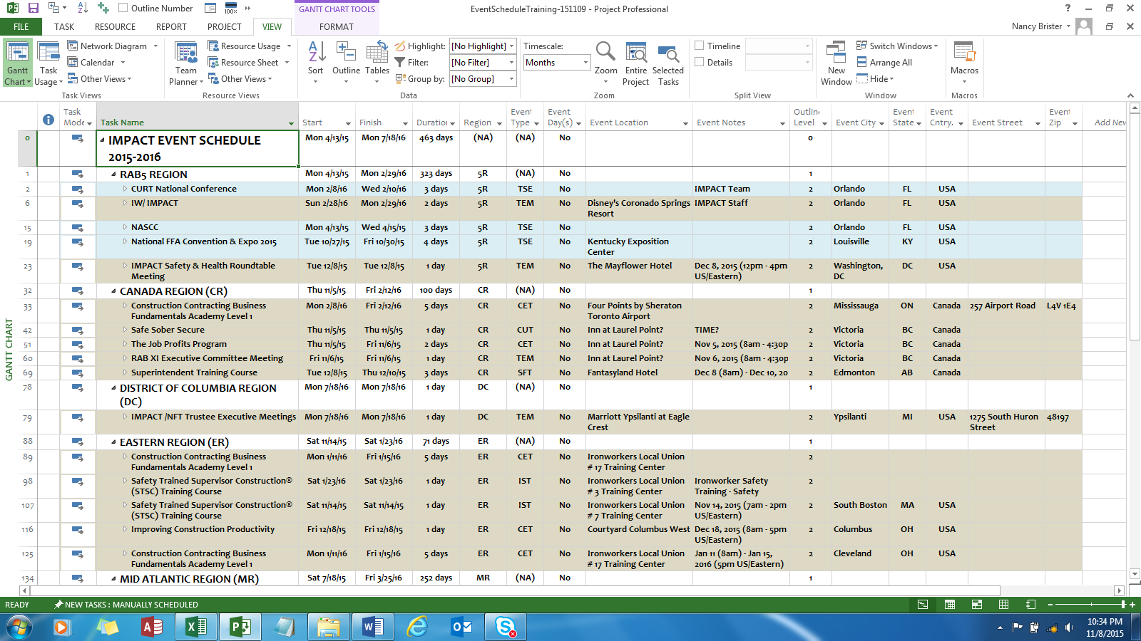
How Key Scheduling Practices Work :
Establishing a Hierarchical, Consistent Framework
Tool (versus “fix”)
Benefits

Slide 12
How to Schedule with Microsoft Project :
DEMO

Slide 13
Additional Notes:

Slide 14
Congratulations!
Wishing you well growing your project success and
Increasing your project management effectiveness
Nancy Brister, PMP

